Slide 1
INORGANIC
COMPOUNDS

Slide 2
INORGANIC COMPOUNDS
Classification
Compounds
Writing formula
Properties
Chemical reactions

Slide 3
Classification of inorganic compounds
OXIDES
ACIDS
BASES (HYDROXIDES)
SALTS
2021-12-05

Slide 4
OXIDES
2021-12-05

Slide 5
OXIDES
Compounds consisting of oxygen and any other element:
Na₂O, SO₂, Al₂O₃
All elements of periodic table except inert gases (group VII)
2021-12-05

Slide 6
Writing oxide formula:
Oxygen oxidation number (ON) in oxides is (-2)
Total sum of ON of any compound is equal to 0
+6 -2 +4 -2
SO SO
...................................................................
+5 -2 +3 -2 +2 -2 +1 -2
N₂O₅ N₂O₃ NO N₂O
...............................................................
+2 -2 +1 -2
MgO Na₂O
3
2
2021-12-05

Slide 7
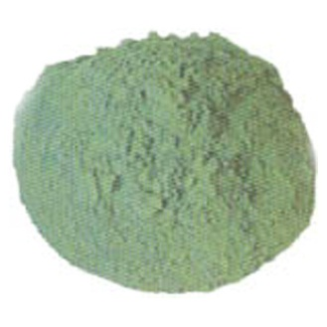
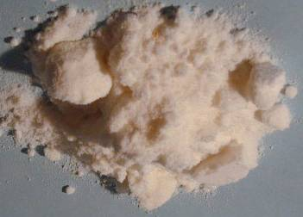
Physical properties of oxides
gases with low liquefying temperature (CO)
fire-resistant (ZrO₂)
good insulators (MgO)
semi-resistant (NiO)
good conductors (ReO)
solid, liquid, gaseous
thermally stable and unstable

Slide 8
Different chemical properties
Basic
Acidic
Amphoteric
Neutral

Slide 9
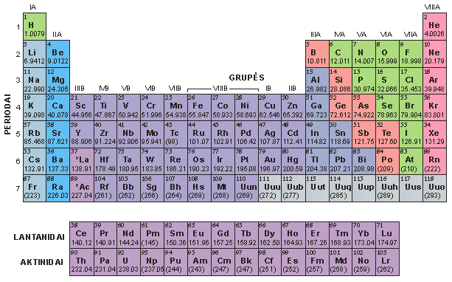

Slide 10
BASIC OXIDES Na₂O, Li₂O, CaO, MgO (oxides of metals)
with water give bases (hydroxides):
Na₂O (s) + H₂O (l) → 2NaOH (aq)
CaO + H₂O → Ca(OH)₂
with acidic oxides and with acids form salts:
Na₂O + SO₃ → Na₂SO₄
CaO + 2HCl → CaCl₂ + H₂O

Slide 11
ACIDIC OXIDES SO₂, CO₂, P₂O₅, N₂O₅ (oxides of non-metals and metals of high valence)
with water give acids:
SO₂ + H₂O → H₂SO₃
SO₃ + H₂O → H₂SO₄
N₂O₅ + H₂O → 2HNO₃
Are called acid anhydrides - H₂SO₄ - H₂O → SO₃

Slide 12
+4
SO₂ +
+4
H₂SO₃
H₂O →
+6
SO₃ +
+6
H₂SO₄
H₂O →

Slide 13
ACIDIC OXIDES
react with basic oxides producing salts:
SO₃ + CaO → CaSO₄
CO₂ + K₂O → K₂CO₃
P₂O₅ + 3Na₂O → 2Na₃PO₄

Slide 14
ACIDIC OXIDES
react with bases (hydroxides) forming salts:
SO₃ + Ca(OH)₂ → CaSO₄+H₂O
CO₂ + 2KOH → K₂CO₃+H₂O
P₂O₅+ 6NaOH→ 2Na₃PO₄+ 3H₂O

Slide 15
AMPHOTERIC OXIDES ZnO, Al₂O₃, SnO₂, PbO₂, BeO, Cr₂O₃
exhibit both properties - acidic and basic:
ZnO + 2HCl → ZnCl₂ + H₂O
ZnO +2NaOH→Na₂ZnO₂ +H₂O
React both with acids and with alkali

Slide 16
AMPHOTERIC OXIDES
EO + H₂O → E(OH)₂
EO – any element combined with oxygen
H-O-E-O-H
If soluble in water, properties depends on whether:
O-H or E-O bond breaks
yields an acid yields a base
Zn(OH)₂ (base) ↔ H₂ZnO₂ (acid)

Slide 17
INERT (NEUTRAL) OXIDES CO, NO, N₂O
do not react neither with acids nor with hydroxides
(salt non-forming oxides)
CO + H₂O →

Slide 18
ACIDS
2021-12-05

Slide 19
ACIDS
Acid is a substance capable of liberating hydrogen ions in a water solution:
HCl = H⁺ + Cl⁻
consist of hydrogen ion and salt anion:
HCl, H₂SO₄, HNO₃,
able to change colour of indicators (litmus paper turn red)
water solutions has a sour taste
react with metals liberating hydrogen
2021-12-05

Slide 20
ACIDS
Oxoacids - H₂SO₄, HNO₃, H₃PO₄
Non-oxoacids - HCl, H₂S, HBr
Monoprotic - containing one H⁺ ion
Polyprotic - containing more than one H⁺ ion
HCl, HNO₃ H₂S, H₂SO₄
2021-12-05

Slide 21
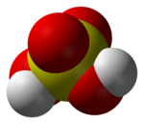
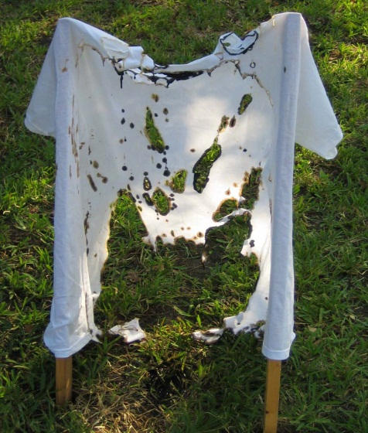
H₂SO₄ – sulfuric acid
diprotic mineral acid
has strong dehydrating, oxidizing
and highly corrosive properties
when hydrogen ions are replaced with metal ions, salts are formed - called sulfates: Na₂SO₄; CaSO₄; Al₂(SO₄)₃

Slide 22
Concentrated sulfuric acid can cause very serious damage upon contact - it hydrolyze and decompose proteins and lipids leading to chemical burn
It also dehydrates carbohydrates resulting in secondary thermal burn
It can cause permanent blindness if splashed to eyes
Therefore, safety precautions should always be taken when using it.

Slide 23
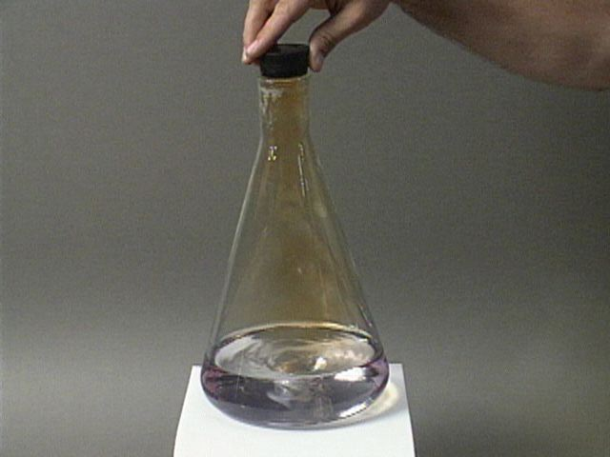
HNO₃ – nitric acid
highly corrosive strong mineral acid salts are called - nitrates: NaNO₃, Ca(NO₃)₂, Al(NO₃)₃

Slide 24
H₃PO₄ – phosphoric acid
Salts called - phosphates: Na₃PO₄, Ca₃(PO₄)₂, AlPO₄

Slide 25
H₂CO₃ - carbonic acid
Salts - carbonates: Na₂CO₃, MgCO₃,

Slide 26
H₂SO₃ – sulfurous acid, salts - sulfites: Na₂SO₃
HNO₂ – nitrous acid, salts – nitrites: NaNO₂

Slide 27
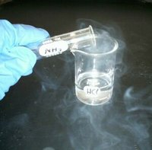
HCl – hydrochloric acid salts – chlorides: NaCl
H₂S – hydrosulfuric acid salts - sulfides: Na₂S

Slide 28
Acids REACT with:

Slide 29
with metals: 2HCl + Fe → FeCl₂ + H₂ with metal oxides: 2HNO₃ + ZnO → Zn(NO₃)₂ + 2H₂O with salts: H₂SO₄ + BaCl₂→2HCl + BaSO₄↓

Slide 30
with hydroxides:
2HCl + Ca(OH)₂ → CaCl₂ + 2H₂O
H₃PO₄ + 3NaOH → Na₃PO₄ + 3H₂O
(neutralisation)

Slide 31
Bases (hydroxides, alkalis)

Slide 32
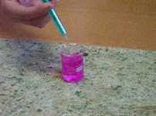
Bases – compounds, which in water release hydroxide anions: NaOH = Na⁺ + OH⁻ (NaOH, Ca(OH)₂) Water soluble hydoxides are called alkalis

Slide 33
Bases REACT with:

Slide 34
with acidic oxides: 2KOH + SO₂ → K₂SO₃ + H₂O with acids: Fe(OH)₃ + 3HCl→FeCl₃ + 3H₂O with salts: 2KOH + CuSO₄→K₂SO₄ + Cu(OH)₂↓

Slide 35
Amphoteric Bases react with acidic oxides and acids: Zn(OH)₂+CO₂→ZnCO₃ +H₂O Zn(OH)₂+2HCI→ZnCl₂+2H₂O with basic oxides and basis: Zn(OH)₂+K₂O→K₂ZnO₂+H₂O Al(OH)₃+3NaOH→Na₃AlO₃+3H₂O

Slide 36
SALTS

Slide 37
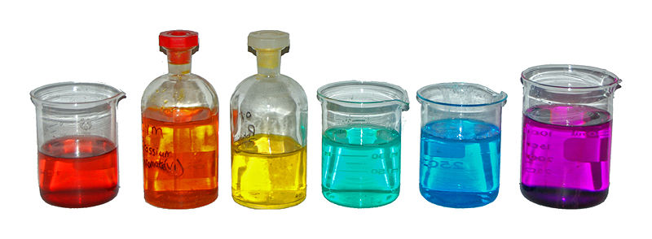
Salts
Are compounds formed from acid anion and
metal or ammonia cation
Co(NO₃)₂ ; K₂Cr₂O₇; K₂CrO₄; NiCl₂; CuSO₄; KMnO₄ .

Slide 38
neutral
acidic
basic
double
complex

Slide 39
Neutral salts are formed only from metal cations and acid anion: NaCl – sodium chloride Mg(NO₃)₂ – magnesium nitrate Double has a cation of several different metals: KCr(SO₄)₂ – potassium-chromium disulfate KMgCl₃ - potassium-magnesium trichloride

Slide 40
Acidic salts beside metal cations has also hydrogen ions: NaH₂PO₄ Ca(H₂PO₄)₂ Na₂HPO₄ CaHPO₄

Slide 41
Acidic salts can be produced only from those acids, which have more than one hydrogen atoms: NaOH_{(shortage)} + H₂SO_{4 (excess)} → → NaHSO₄ + H₂O

Slide 42
Basic salts beside acid anion have a hydroxy- group: MgOHCl - magnessium hydroxychloride Basic salts can be produced only from those basis, which have more than one hydroxy-group: Mg(OH)₂ + HCl_{(shortage)} → MgOHCl +H₂O

Slide 43
Complex salts – is a product of reaction between several different compounds They are formed from complex ions: e.g.: pottassium hexacyanoferrate (II): K₄[Fe(CN)₆ ] outer sphere inner sphere Fe – complexing agent CN - ligand [Fe(CN)6] ⁺⁴- complex ion

Slide 44
Influence of ligands on the colour of complex compounds: [Co(NH3)5Cl](NO3)2, [Co(NH3)5Br](NO3)2, [Co(NH3)5I](NO3)2, [Co(NH3)5NO2](NO3)2, [Co(NH3)5SO4](NO3)2

Slide 45
Hazardous chemical compounds

Slide 47
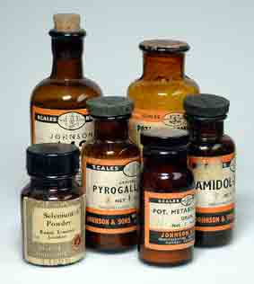
Chemicals are labeled:
danger symbols
hazard statements
standard risk and safety phrases

